Slide 1
DevOps Pipeline
Infrastructure Automation and Container Deployment on Azure
Terraform → Ansible → Docker → GitHub Actions
PART 1
Terraform
PART 2
Ansible
PART 3
Docker
PART 4
CI/CD

Slide 2
OVERVIEW
Project Overview
Goal: Automate the full deployment lifecycle of a web application on Microsoft Azure
01
02
03
04
Provision
Configure
Containerise
Automate
Create cloud infrastructure
using Terraform on Azure
Install Docker on VM
using Ansible over SSH
Package app with Docker
serve with Nginx on port 8080
Deploy on every git push
using GitHub Actions
Azure Student Subscription | Norway East Region | Ubuntu 24.04 LTS
2 / 22

Slide 3
TOOLS
Tools Used
Terraform
Infrastructure as Code - Cloud resource provisioning
by HashiCorp
Ansible
Configuration Management - Agentless automation over SSH
by Red Hat
Docker + Nginx
Containerisation - Isolated portable application runtime
by Docker Inc
GitHub Actions
CI/CD Pipeline - Auto deploy on every code push to main
by GitHub
3 / 22

Slide 4
ARCHITECTURE
How All 4 Parts Connect
PART 1
PART 2
PART 3
PART 4
Terraform
Ansible
Docker
CI/CD
Provision VM
VNet NSG IP
→
→
→
Install Docker
/opt/app
Build image
Run container
Auto deploy
on push
git push → GitHub Actions runner → Ansible → Azure VM → Docker → Live App ✓
Key Integration Principle
ansible/deploy.yml is the single source of truth for all deployment logic.
Part 3 wrote it - Part 4 reuses it directly. No duplication across the pipeline.
Each part builds on what the previous part produced.
4 / 22

Slide 5
PART 1
Infrastructure Setup
Tool: Terraform by HashiCorp
Define cloud infrastructure in code - provision and destroy with a single command.
Version controlled. Repeatable. No human error from manual portal clicks.
Used by Netflix · Uber · Slack · JP Morgan Chase
5 / 22

Slide 6
PART 1 - TERRAFORM
What is Infrastructure as Code?
✗
Without IaC
Click through Azure Portal manually - easy to miss steps, no record of changes
✓
With IaC
Define everything in .tf files - run terraform apply same result every time
⌥
Version Control
Store in GitHub - teams review, revert and collaborate on infrastructure
⟳
Repeatable
Destroy and recreate with one command - identical environment, zero drift
6 / 22

Slide 7
PART 1 - TERRAFORM
Azure Resources Provisioned
Resource Group
Public IP Address
Container for all related Azure resources
Static IP - Makes VM reachable from internet
Virtual Network
Network Interface
10.0.0.0/16 - Isolated private network
Connects VM to Subnet and Public IP
Subnet
Linux Virtual Machine
10.0.1.0/24 - VM lives inside this subnet
Ubuntu 24.04 LTS | Standard B1s | Norway East
Network Security Group
Firewall - Port 22 SSH | Port 80 HTTP | Port 8080 App
VM ← NIC ← Subnet ← VNet ← NSG ← Public IP - all connected in this chain
7 / 22

Slide 8
PART 1 - CHALLENGES
Challenges and Workaround
Problem
terraform apply returned 403 Forbidden for VNet, NSG and Public IP.
Azure Student Subscription restricts resource creation in many regions.
No official list of allowed regions provided - required trial and error.
Resolution
Infrastructure provisioned manually through Azure Portal in Norway East region.
Terraform scripts retained in repository as IaC documentation of intended approach.
Lesson
Real cloud environments have subscription constraints requiring adaptation.
Understanding both automated and manual approaches demonstrates deeper knowledge.
8 / 22

Slide 9
PART 2
Configuration Management
Tool: Ansible by Red Hat
Write tasks in YAML - Ansible runs them on the VM over SSH.
No agent installed on the server. No manual SSH required.
Idempotent - safe to run multiple times with the same result.
9 / 22

Slide 10
PART 2 - ANSIBLE
Playbook Structure
ansible.cfg
Global settings - SSH options, inventory path, disable host key checking
inventory/hosts.ini
VM IP address and SSH user details
setup.yml ★
Main entry point - calls the configuration role
roles/configuration/tasks/main.yml
All 10 installation and configuration steps defined here
roles/configuration/handlers/main.yml
Restarts Docker only when a change is actually made
deploy.yml ★
Deployment playbook - entry point for Part 3 and Part 4 CI/CD
10 / 22

Slide 11
PART 2 - ANSIBLE
Configuration Tasks on VM
01
apt-get update
06
Enable Docker on boot
Prevents broken dependencies
systemd - auto starts on reboot
02
Install prerequisites
07
Start Docker service
curl git ca-certificates gnupg
Running immediately after install
03
Add Docker GPG key
08
Add user to docker group
Verifies official Docker source
No sudo needed for docker commands
04
Add Docker repository
09
Create /opt/app directory
Registers Docker apt source
Deployment target - owned by user
05
Install Docker Engine
10
Verify installation
docker-ce docker-ce-cli containerd
docker --version systemctl status
11 / 22

Slide 12
PART 3
Docker Container Deployment
Tools: Docker + Nginx + Ansible
Package the application in a container - runs identically on any machine.
Nginx serves the HTML page inside the container on port 80.
Deployed to the VM automatically using the Ansible deploy.yml playbook.
Used by Google · Amazon · Netflix
12 / 22

Slide 13
PART 3 - DOCKER
Dockerfile Breakdown
FROM nginx:alpine
→ Base image - 23MB vs 140MB for full Nginx image
RUN rm -rf /usr/share/nginx/html/*
→ Remove default Nginx welcome page
COPY src/ /usr/share/nginx/html/
→ Copy our HTML into the directory Nginx serves
COPY nginx.conf /etc/nginx/conf.d/default.conf
→ Replace default config with our custom Nginx config
EXPOSE 80
→ Declare the port the container listens on
CMD ["nginx", "-g", "daemon off;"]
→ Start Nginx in foreground - keeps container running
13 / 22

Slide 14
PART 3 - DOCKER
How Traffic Reaches the App
Browser
Azure NSG
Azure VM
Docker
Nginx
index.html
http://VM_IP
:8080
→
Port 8080
inbound rule
→
Port 8080
Norway East
→
8080 → 80
Port mapping
→
Port 80
Inside container
→
Response
HTTP 200 ✓
docker-compose.yml
container_name: webapp | ports: "8080:80" | restart: always
Ansible deploy.yml - Steps
Create /opt/app → Copy app/ files → Remove old containers
docker-compose build → docker-compose up → Wait 5s → Verify HTTP 200
14 / 22

Slide 15
PART 4
CI/CD Pipeline Integration
Tool: GitHub Actions
Push code to GitHub - application is live in under 2 minutes.
No manual SSH. No manual build. No manual deploy.
Every step logged and visible in GitHub Actions.
15 / 22

Slide 16
PART 4 - GITHUB ACTIONS
Pipeline Steps
1
Checkout repository
Runner gets access to app/ and Ansible/ folders
2
Install Ansible
apt-get install ansible - runner is a fresh Ubuntu machine each run
3
Write SSH private key
VM_SSH_KEY decoded from base64 → ~/.ssh/id_rsa chmod 600
4
ssh-keyscan
Add VM fingerprint to known_hosts - prevents SSH confirmation prompt
5
Generate hosts.ini
VM_HOST and VM_USERNAME from secrets - IP never hardcoded in repo
6
ansible-playbook deploy.yml ★
Ansible connects to VM via SSH - runs all Docker deployment steps
7
Print live URL
http://VM_IP:8080 printed to pipeline log
16 / 22

Slide 17
PART 4 - GITHUB ACTIONS
GitHub Secrets Configuration
Settings → Secrets and variables → Actions → New repository secret
VM_HOST
Value:
Azure VM Public IP Address
How to get it: Azure Portal → test-vm → Overview
VM_USERNAME
Value:
mateen
How to get it: Fixed value - type as shown
VM_SSH_KEY
Value:
Base64 encoded private SSH key
How to get it: Run: base64 -w 0 ~/.ssh/id_rsa
17 / 22

Slide 18
DESIGN PRINCIPLE
Single Source of Truth
ansible/deploy.yml owns all deployment logic - used by both manual runs and CI/CD pipeline
Before - Logic Duplicated
After - No Duplication
GitHub Actions:
docker stop webapp
docker rm webapp
docker run webapp
Ansible deploy.yml:
docker stop webapp
docker rm webapp
docker run webapp
GitHub Actions:
ansible-playbook deploy.yml
Ansible deploy.yml:
docker stop webapp
docker rm webapp
docker run webapp
→
If deployment logic changes - update deploy.yml once.
Both manual deploy and CI/CD pipeline are fixed automatically.
18 / 22

Slide 19
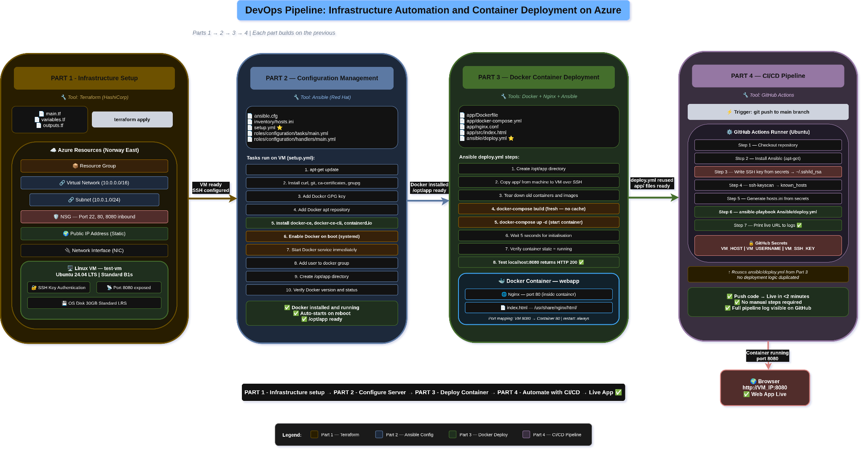
PIPELINE DESIGN
Architecture Diagram
19 / 22

Slide 20
END TO END FLOW
Complete Automated Flow
git push
Old container removed
Developer pushes code change to main branch on GitHub
docker-compose down - stops and removes previous container
GitHub detects push
docker-compose build
Actions runner starts - fresh Ubuntu VM provisioned by GitHub
Fresh image built from Dockerfile - build: always no cache used
Runner setup
docker-compose up
Checkout repo → Install Ansible → Write SSH key to id_rsa
Container started - port 8080:80 mapped - restart: always set
Ansible connects
HTTP 200 verified
SSH into Azure VM using private key from secrets
Ansible confirms app responds on localhost:8080
Files copied to VM
Live in < 2 minutes ✓
app/ folder transferred over SSH into /opt/app on the VM
Browser hits http://VM_IP:8080 and sees updated application
20 / 22

Slide 21
VERIFICATION
Verification Commands
$ docker --version
→ Docker version 24.2.0
Part 2
$ sudo systemctl status docker
→ active (running)
Part 2
$ sudo systemctl is-enabled docker
→ enabled
Part 2
$ getent group docker
→ docker:x:999:mateen
Part 2
$ docker ps
→ webapp Up X min 0.0.0.0:8080->80/tcp
Part 3
$ curl http://localhost:8080
→ HTTP 200 index.html returned
Part 3
$ docker logs webapp
→ Nginx started - no errors in logs
Part 3
$ GitHub Actions → green check
→ All steps passed PLAY RECAP ok=7 changed=3
Part 4
21 / 22

Slide 22
Conclusion
Full pipeline completed
All 4 parts working and integrated end to end
Zero manual steps
git push → live deployment in under 2 minutes
Single source of truth
deploy.yml reused across manual and automated flows
Real constraints handled
Azure student limits solved - SSH key issue debugged and fixed
Industry standard tools
Terraform Ansible Docker GitHub Actions - all in demand in DevOps
22 / 22

